Slide 1


Team Members
Nathan Fuchs
Andrew Ferko
Nicholas Bragdon
Brandon Walker
Sponsors
Steve Mckinnon
Tyler Cross

Slide 2





Everything is Connected
bwc.com/call/BrandonWalker

Slide 3







Everything Is Connected

Slide 4
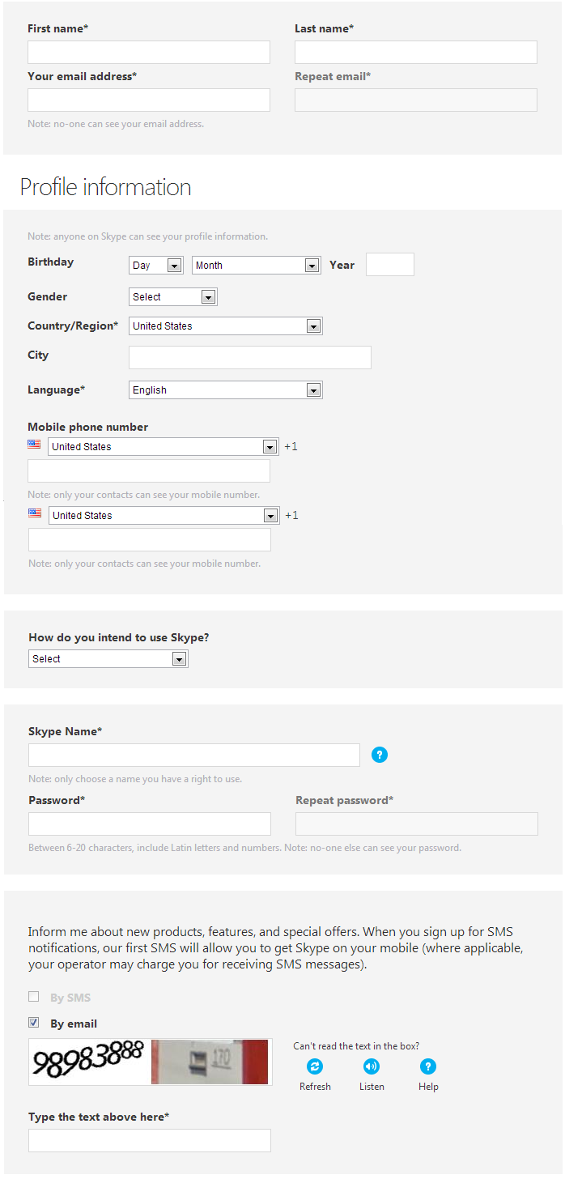
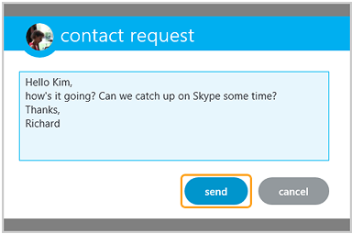
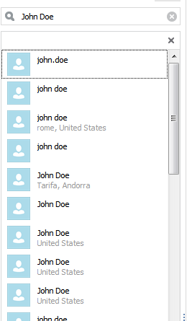
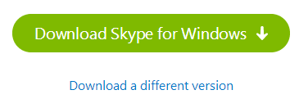
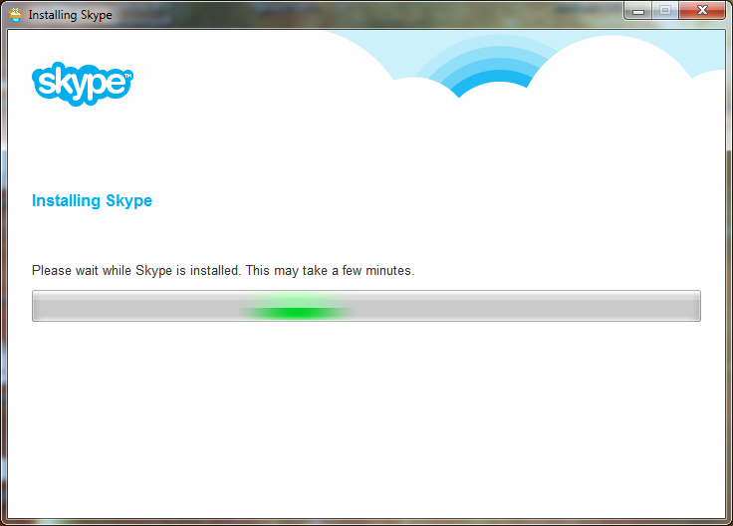
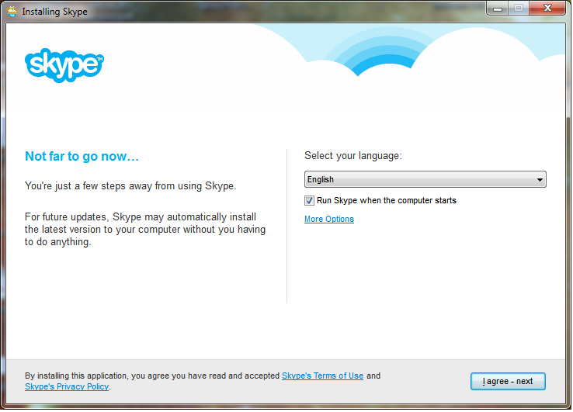
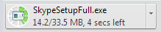
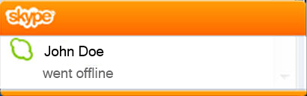
How is this innovative?

Slide 5
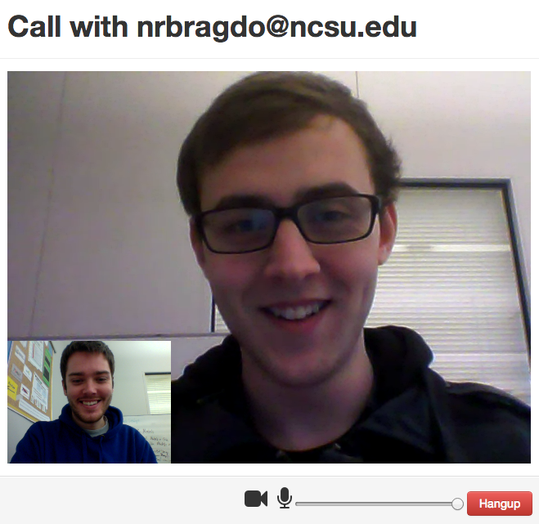

Communication Simplified
bwc.com/call/NicholasBragdon

Slide 6

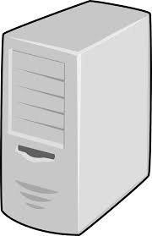
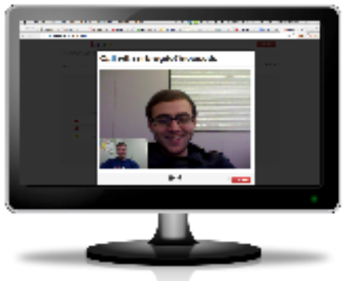
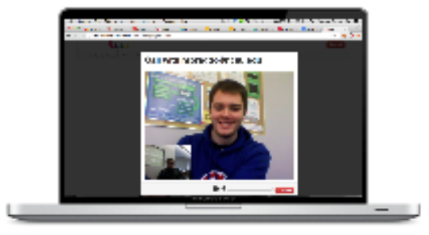
Without WebRTC
With WebRTC
X
Internet

Slide 7





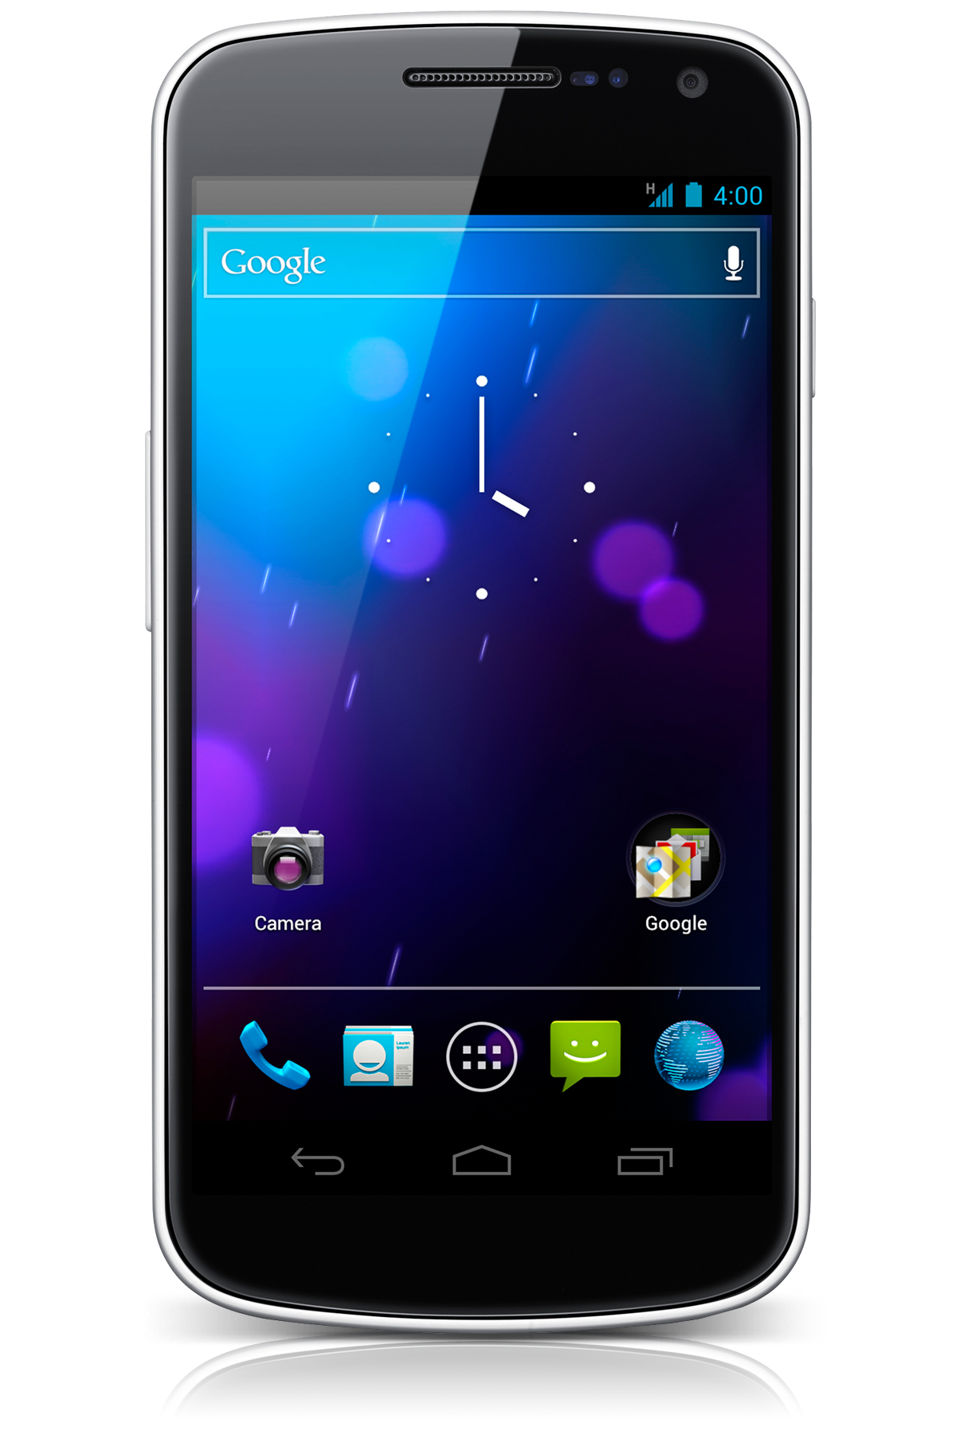

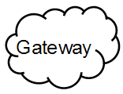






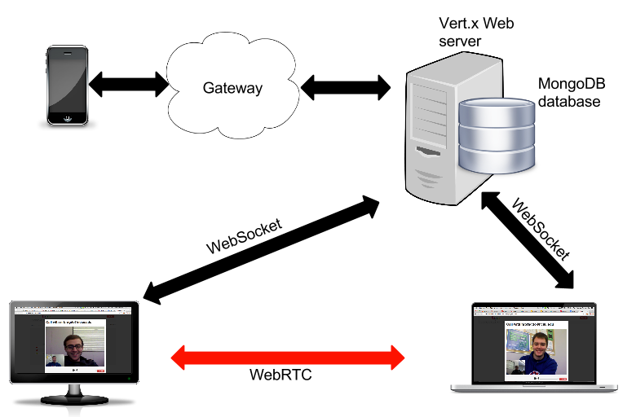
Architecture
REST
MongoDB
WebSocket
WebSocket
WebRTC

Slide 8


With thanks to GENBAND for the use of the GENBAND SPiDR webRTC Gateway

